Slide 1


DBT Mission
Cabinet Secretariat, Govt. of India
Direct Benefit Transfer Mission
Cabinet Secretariat, GoI
16th -17th July, 2025

Slide 2
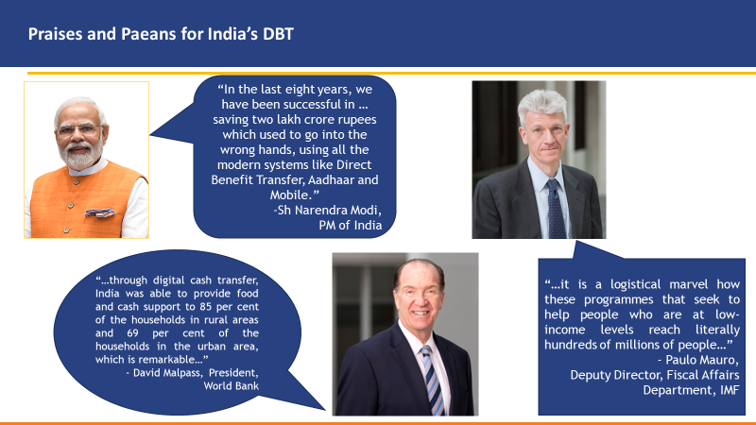
DBT – Appreciation (1/2)

Slide 3

DBT – Appreciation (2/2)
“Aadhaar is the most important technological system in the world right now. It has laid the foundation of a platform to enable people to avail government benefits, including direct benefit transfer” – Paul Romer, Nobel Laureate and former chief economist of The World Bank

Slide 4
DBT (Direct Benefit Transfer)
D
Direct – Without any middlemen
B
Benefits – Cash and In-kind
T
Transfers – Electronic; Authentication-based

Slide 5
Direct Benefit Transfer (DBT) Genesis
Launched about a decade ago as a good governance reform initiative aimed at improving public service delivery to ensure that the benefits are delivered efficiently and timely.
Tool for re-engineering Government processes.
DBT Mission
  Nodal Point for Implementation of DBT in India
  Initially created in Planning Commission (now NITI Aayog) in 2012
  Transferred to Department of Expenditure in July, 2013
  Transferred to Cabinet Secretariat in September, 2015

Slide 6

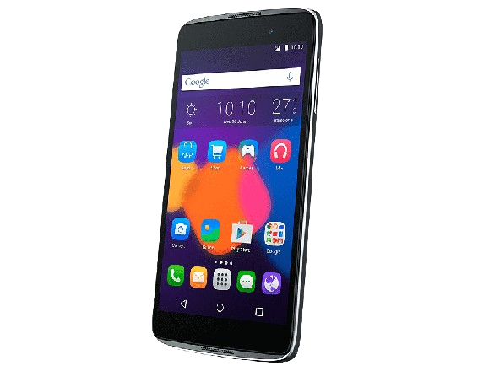
JAM trinity as foundation for DBT
J
A
M
Pradhan Mantri Jan-Dhan Yojana
Aadhaar
Mobile
Banking infrastructure in 650,000 villages
Unique digital identity
Mobile connectivity
55.48 Cr. Accounts (deposits ₹2.56 lakh cr)
Total bank accounts 174 Cr
141 crore Aadhaar
117 cr mobile phones
85 cr smartphones

Slide 7
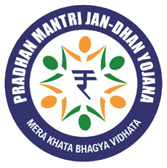
JAM (Jan Dhan, Aadhaar, Mobile) - Key enablers of DBT
A. Jan Dhan (Banking / Financial Facilities)
Jan Dhan Yojana (National Financial Inclusion Drive) : Opened low value bank accounts for 55.48 cr customers (55% women a/c)
Doorstep delivery of banking services: Through the vast infrastructure of the Business Correspondents and Department of Post and India Post Payments Bank, Post Offices (155,000), Gramin Dak Sevaks (256,000)
Accessible cash out points: Bank Branches (120,000), ATMs (2.55 lakh), Micro-ATMs (17.5 lakh)
Common Service Centres (5,76,149) in addition to the existing banking infrastructure
Jan Dhan Darshak Mobile App: Helps locate financial service touch point(s)

Slide 8
Who is a beneficiary?
Why DBT?
Why DBT?
To ensure accurate targeting of the beneficiary
To perform de-duplication
To curb pilferage
To remove middle-men
To transfer benefits electronically to the bank account of the beneficiary, preferably using Aadhaar Payment Bridge (APB)
An individual or ‘group of individuals’ receiving any advantage, relief, payment etc. in cash or in-kind from the Consolidated fund of India. (Ref.: Preamble and Section 2(f) of ‘The Aadhaar Act, 2016’)

Slide 9
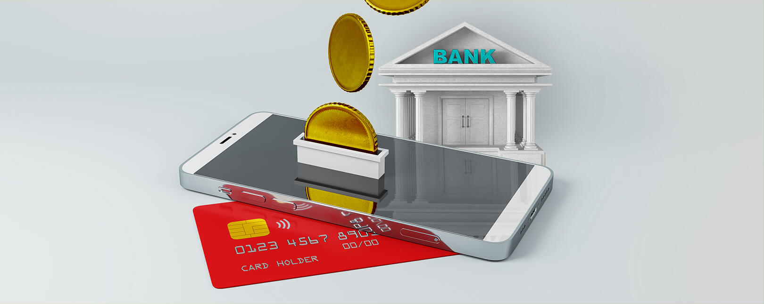

Types of DBT - Cash
Examples
z
Cash subsidy entails the government transferring money directly to bank account of the targeted, identified beneficiaries electronically and also ensures adequate cash out points
Cash-In
Social Security Pensions
Subsidy & Welfare Schemes
(Eg. MGNREGS, PAHAL, PM-Kisan)
Cash
Out
Scholarships & Fellowships

Slide 10
Types of DBT – In Kind
In-kind transfers are benefits the government provides to targeted, identified and Aadhaar authenticated beneficiaries in the form of goods and services
Examples
Delivery of In-kind subsidies
(Eg. food, fertilizer etc.)
Training & Skill Development

Slide 11
How to identify a DBT Scheme ?
If it is funded from Consolidated Fund of States (except in Section 4(4)(b)(ii) and 4(7)).
If benefit (Cash or In-Kind) is given to individual beneficiary or group of beneficiaries (Ref.: Section 2(f) of Aadhaar Act).
If the Scheme can be notified under Aadhaar Act (Section 7 or 4(4)(b)(ii) or 4(7).
If cash benefit can be directly transferred to bank account of the beneficiaries.
If In-Kind benefit can be transferred after Aadhaar Authentication.

Slide 12
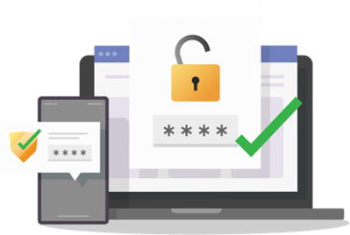
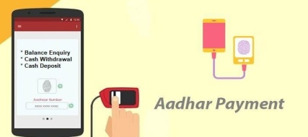
End To End Digitization
Application
Processing
Benefit Delivery
Registration
Provision for online application through self and assisted mode
Computerized processes for generation of Beneficiary List
Electronic payments for cash schemes and Digital authentication for In-kind schemes

Slide 13
Savings

Slide 14
DBT Savings: States/UTs
July 2016-
Inter-State Council meeting chaired by Hon’ble Prime Minister wherein it was observed that DBT has resulted in huge savings
Cabinet Secretary requested to follow up and obtain report from States (Para 76 of RoD)
DBT Mission (Cabinet Secretariat) pursuing with the States regularly
August 2017-
‘Use of Aadhaar and DBT’ included on the Agenda of Inter-State Zonal Council meetings.
DBT Mission is invited to the Zonal Council meetings (Chaired by Hon’ble Home Minister) and Standing Committee meetings (Chaired by Chief Secretary of the host State)
December 2017
Broad Guidelines/Methodology for assessing Benefits finalized by Group of Secretaries.

Slide 15
Guidelines/Methodology : Tangible & Intangible
Both tangible and intangible savings to be reported.
Tangible savings reflect the benefit through de-duplication and removal of fake/non-existent beneficiaries. Intangible savings There may be no tangible savings for: a) New schemes starting with Aadhaar-based beneficiary database; b) Schemes with one-time benefit and; c) New beneficiaries who have been verified through Aadhaar, for an existing scheme. However, such cases will have other benefits like reduction of time, process simplification, greater inclusion, cost to Government which should be suitably assessed.

Slide 16
Guidelines/Methodology : Recurring Schemes
Recurring Schemes
In schemes where benefits are recurring nature, for the first year the savings would be on basis of actuals, in terms of amount saved for such removed beneficiaries. For subsequent years, savings may be notional.
If active or current beneficiaries are less than the total number of eligible beneficiaries, data on savings may be calculated for beneficiary records deleted/ de-duplicated/ removed against the active or current beneficiaries in a fiscal year, rather than the larger list of total eligible beneficiaries.

Slide 17
Guidelines/Methodology: General
General
Beneficiary may become ineligible for certain benefits by virtue of benefitting under some other scheme. Such cases, however, may not be noticed due to segregated beneficiary databases. To undertake de-duplication Deptts. may, develop a comprehensive database of all the schemes under the Ministry’s purview to correctly identify beneficiaries from receiving multiple benefits
Reduction in beneficiary list due to reasons such as death, migration, changes in eligibility requirements may not to be counted as savings
For, open-ended schemes where there is no defined beneficiary list (such as Fertilizers or Health care schemes), other factors remaining the same, savings could be computed based on the total spending in the pre-DBT scenario compared to total spending in the post-DBT scenario

Slide 18
Illustrative Examples (1/3)
Scheme | Methodology
PAHAL (DBTL) – M/o Petroleum & Natural Gas | [No. of LPG beneficiary records blocked/deleted] X [average subsidy per cylinder] X [no. of entitled cylinders per beneficiary]
PDS– D/o Food & Public Distribution | a) On account of digitisation and Aadhaar seeding of PDS beneficiary database: No. of ration cards deleted due to fake/ non-existent/ duplicate/ ineligible beneficiaries X amount of subsidy entitlement per beneficiary b) On account of automation of FP Shops, requiring biometric authentication: Difference in the cost of PDS Ration (subsidy element) distributed in pre and post DBT scenario. Total Savings (a) + (b)

Slide 19
Illustrative Examples (2/3)
Scheme | Methodology
MGNREGS – M/o Rural Development | a) On account of digitisation and Aadhaar seeding of Job cards beneficiary database: No. of Job cards deleted due to fake / non-existent/ duplicate/ ineligible beneficiaries X NREGA wage entitlement per beneficiary. b) On account of biometric authentication at the time of payment of wages (as & when introduced) Difference in the wage bill in pre & post biometric authentication scenario. Total Savings (a) + (b)

Slide 20
Illustrative Examples (3/3)
Scheme | Methodology
Fertilizers – D/o Fertilizers | On account of biometric authentication of purchasers:
 | Difference in cost of fertilizer off-take (subsidy element) in pre and post DBT scenario
Scholarships– M/o Minority Affairs, M/o Social Justice and Empowerment, M/o Labour & Employment | On account of digitization and Aadhaar seeding of beneficiary database and direct credit in beneficiary’s bank account: No. of records deleted due to fake/non-existent/ duplicate/ ineligible beneficiaries X Scholarship entitlement per beneficiary
NSAP (pension) – M/o Rural Development | On account of digitisation and Aadhaar seeding of pension database, and direct credit in beneficiary’s bank account: No. of pension records deleted due to fake/non-existent/ duplicate/ ineligible beneficiaries X pension entitlement per beneficiary

Slide 21
Benefits / Gains due to DBT
Rs. 3,48,564.66 crore Benefits / Gains due to removal of more than 10 crore duplicate, fake/ non-existent beneficiaries across schemes
Scheme |  | Cumulative since inception Cr.
PDS |  | 1,85,573.28
PAHAL |  | 73,443.34
MGNREGS |  | 42,534.14
Fertilizer Subsidy |  | 18,699.89
Scholarships | MoMA | 1,916.79
 | SJ&E | 1,054.65
Supplementary Nutrition Program of Aanganwadi |  | 1,523.75
NSAP |  | 537.10
Others |  | 1,175.58
Cumulative Estimated Benefits / Gains
In Rs. crore
Savings of Rs 27,030 cr reported by States
Savings of Rs 2,079.53 crore been reported by Rajasthan upto FY 2022-23
(to be updated upto FY 2024-25)

Slide 22
Thank You

Slide 23

Legal Provision -Aadhaar
Shaped by the Supreme Court’s judgment in 2018 and Amendment in 2019, use of Aadhaar is governed by following provisions of Aadhaar Act:
Section 4 (7): Authentication mandatory under the provisions of laws made by Parliament (eg PAN)
Section 4(4)(b)(i): Enabling provision for voluntary authentication, under any other law made by Parliament (Eg. entities regulated IRDAI, SEBI and Prevention of Money Laundering Act)
Section 4 (4)(b)(ii): Enabling provision for voluntary use of Aadhaar, in the interest of State (but no denial of service) (Health ID etc)
Section 7: Aadhaar authentication, subject to the condition that alternate and viable means of identification are available and Aadhaar enrolment is facilitated. This section is used for DBT and was upheld by the SC in its 2018 judgement. Exception handling in place.
Section 3A: Parental consent must for children less than 18 years of age; No denial of services or benefits on authentication failure.
Section 29: Purpose limitation – Restriction on sharing information.
‘Ministries/Departments of the Government of India’, however can be treated as a single entity (OM of UIDAI dated 27.10.2021). Further, consent-based sharing of data permitted between centre and state.
23

Slide 24
Good practices for use of Aadhaar
Design workflow to incentivize Aadhaar usage
Promote use of Aadhaar through ‘nudge’ policies- PM KISAN, AYUSHMAN BHARAT(PMJAY),PMMVY, NSP etc.
Conduct detailed scrutiny of applications not supported by Aadhaar- NSP(red flagging)
Where beneficiaries are minors,
  Either take Aadhaar/EID of minors with consent of parents; or
  Take the Aadhaar of parents/ legal guardian after suitable amendment to the scheme guidelines, if necessary.

Slide 25
Progress in Aadhaar seeding/ Authentication
Interim SC Orders (2013-16) & Inclusion of In-kind schemes
Hon’ble Supreme Court Judgment
Covid-19 Pandemic
Mandatory requirement
for vault
Centralised Aadhaar data vault
Aadhaar Act
Amendment
2024-25 data is Provisional

